Slide 1
Let’s practice questions!

Slide 2
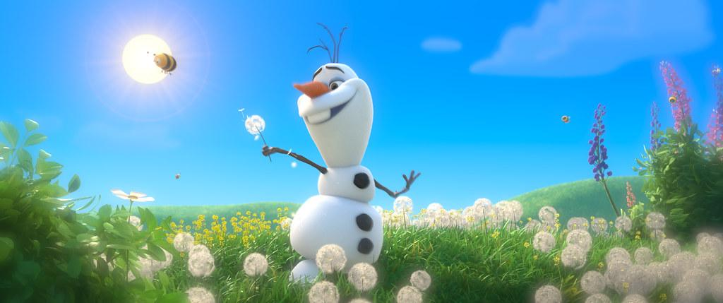
What’s your name?
My name is ____________.
Don’t forget! We can imagine/invent new or silly names!
OLAF

Slide 3
How are you?
I am ______.
I’m _______.
hungry
excited
thirsty

Slide 4
Where are you from?
I am from
________.

Slide 5
What
is the
date
today?
Today is...
Yesterday
was...
Tomorrow
will be…

Slide 6
It’s sunny
How’s the weather?

Slide 7
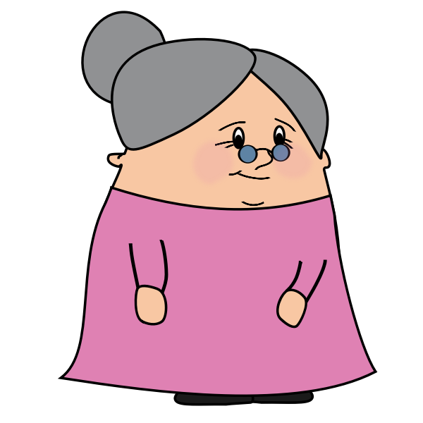
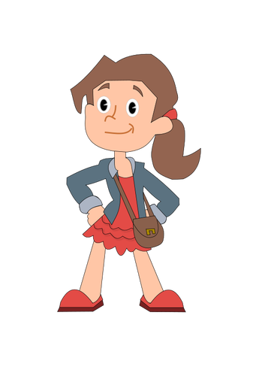
How old are you?
I’m _____.

Slide 8
My birthday is _______.
When is your birthday?

Slide 9
Do you have siblings?
I have ___.

Slide 10
What languages do you speak?
I speak
________.

Slide 11
It’s ____.
What time is it?

